Slide 1
EE464 Hardware Project Presentation
Deniz Boran KARACA-
Mert Yaşar AYDIN-
Canberk DUMAN-

Slide 2
Design Procedure

Slide 3
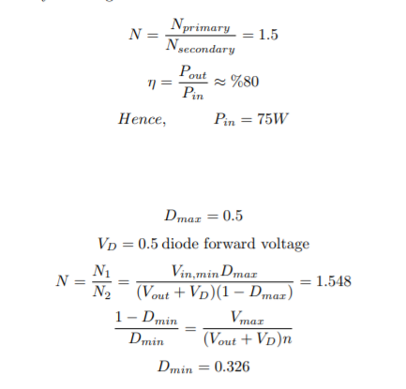
Parameter Selection

Slide 4

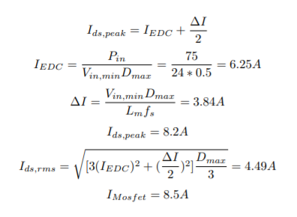
Mosfet:
Mosfet Rating:

Slide 5
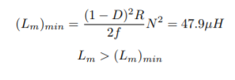

Magnetizing Inductance
Checking boundary magnetizing inductance:
Choosing magnetizing inductance:

Slide 6


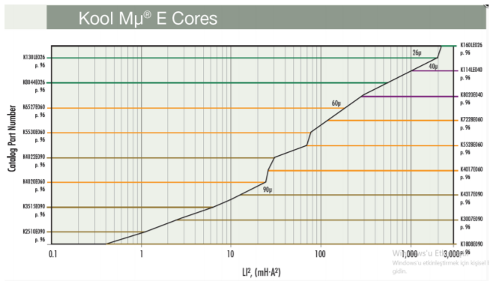
Magnetic Design
Average current of the transformer:

Slide 7
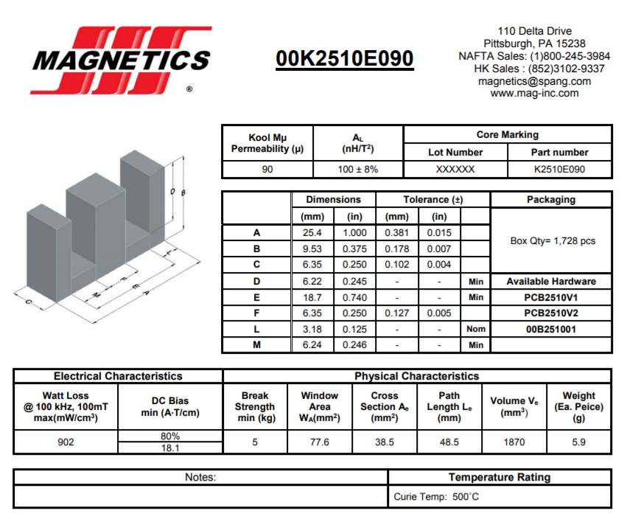

Slide 8
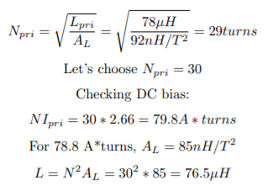

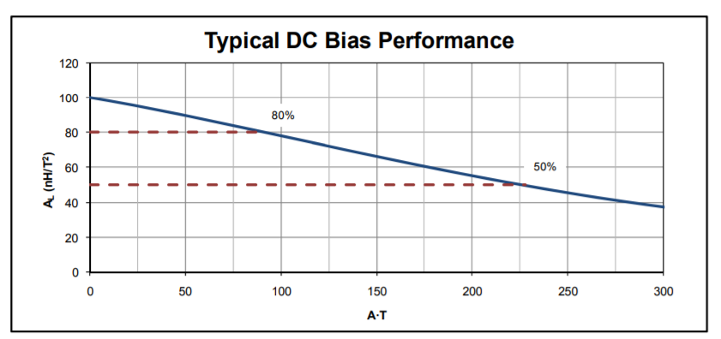

Slide 9
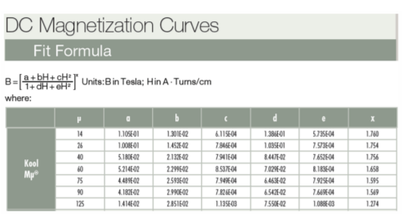

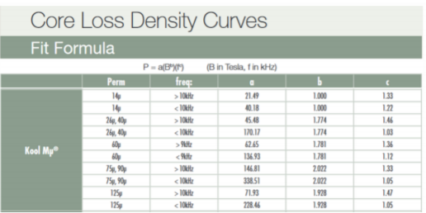


Slide 10
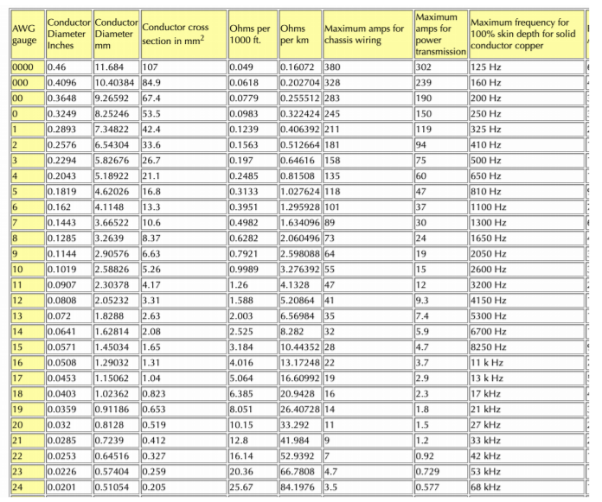
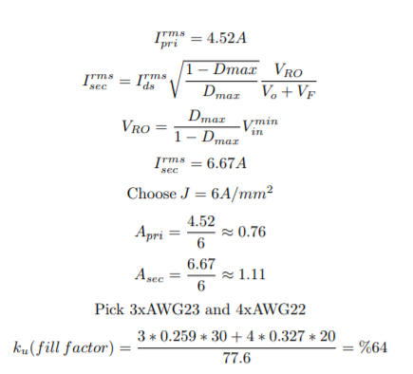
Wire Selection

Slide 11

Copper Loss:
Neglecting proximity effect:

Slide 12

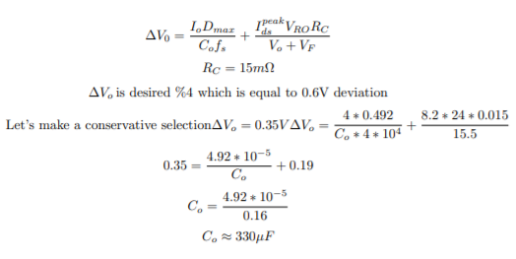
Diode and Output Capacitor
Diode:
Output Capacitor:

Slide 13
Component Selection

Slide 14


Mosfet:
Assuming %30 spike
Diode:

Slide 15
Transfer Function Derivation

Slide 16
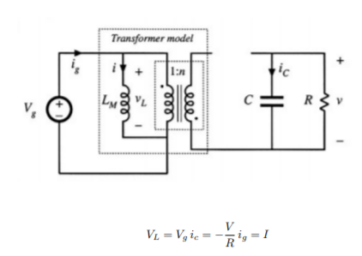
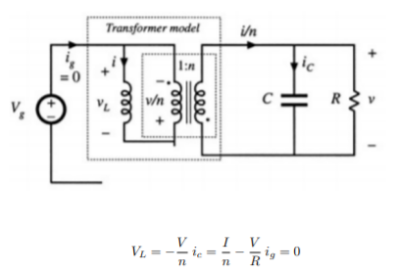

On-Off States
Averaging:

Slide 17
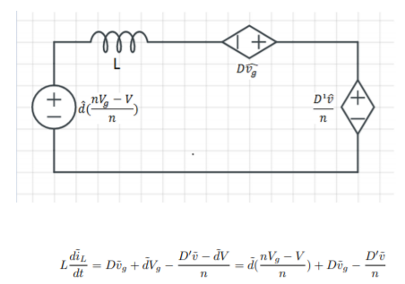
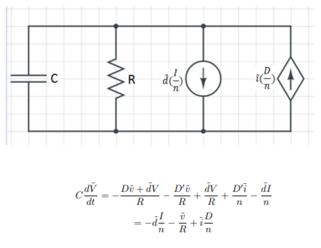
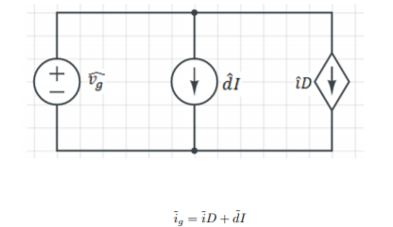

Slide 18

Overall Circuit

Slide 19
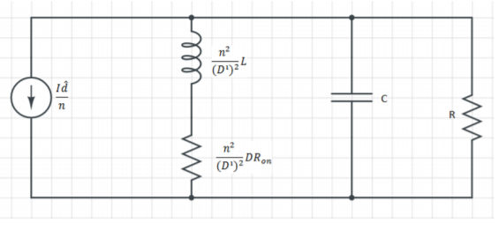
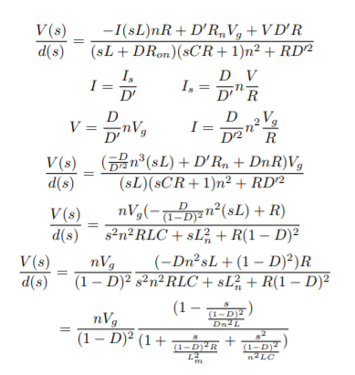
Superposition
Killing Voltage Source

Slide 20
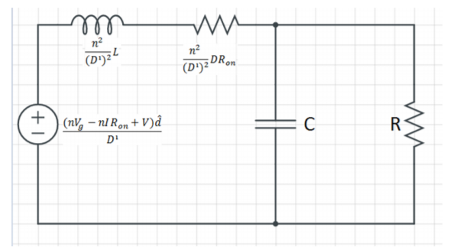

Killing Current Source

Slide 21

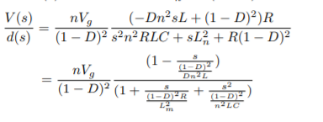
Arranging Terms
RHP Zero and Double pole!

Slide 22
Compansator Design

Slide 23
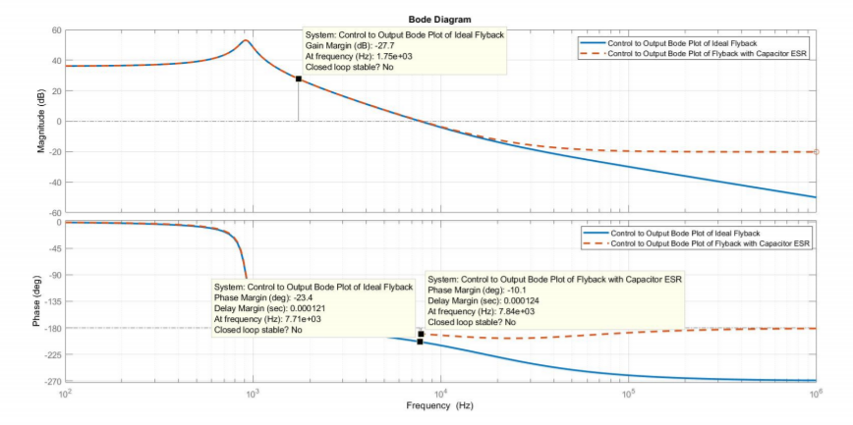
Bode Plots
ESR of capacitor introduces a zero at:

Slide 24
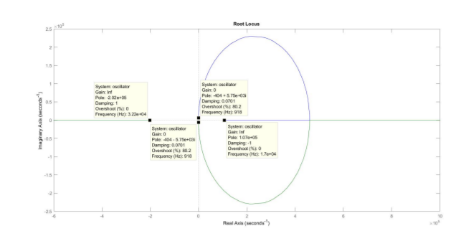

Crossover frequency selection:

Slide 25
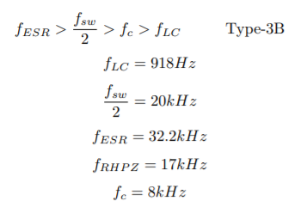
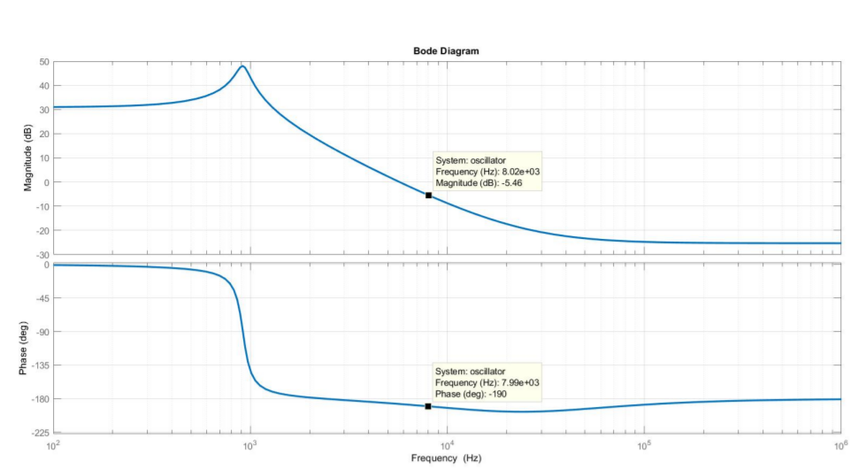


Selecting Type of Error Amplifier

Slide 26
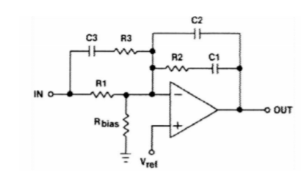
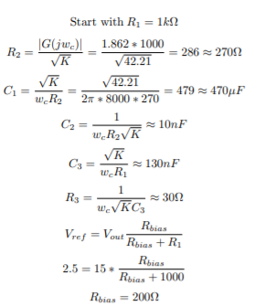

Finding Components
K-method:

Slide 27
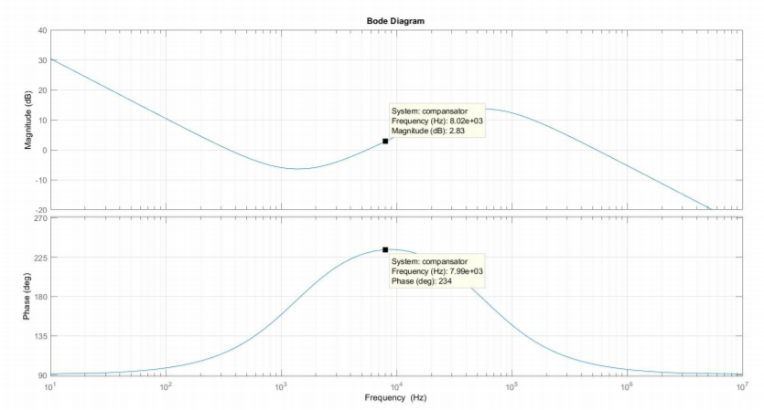
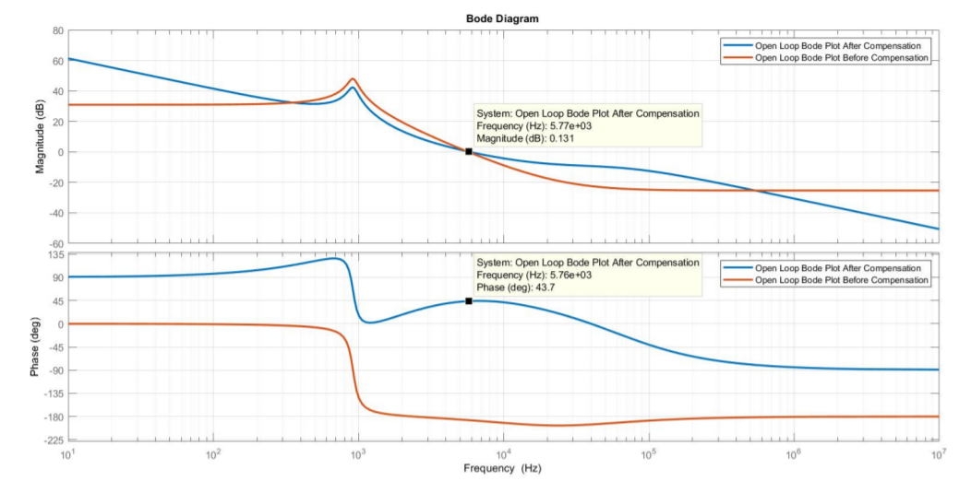

Slide 28
Thermal Analysis

Slide 29
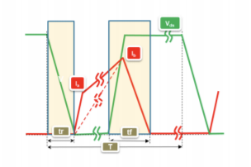

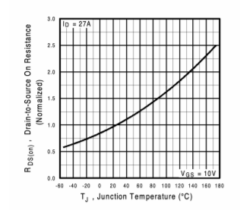

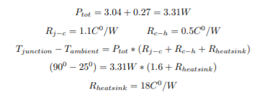
Mosfet Heatsink
Operating junction temperature is chosen 90 Celcius.

Slide 30
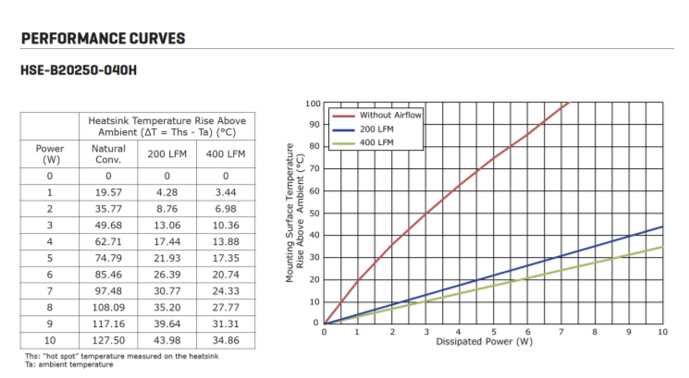

Slide 31
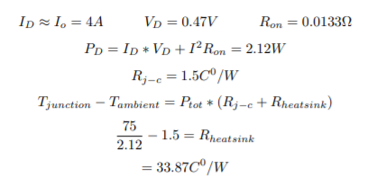
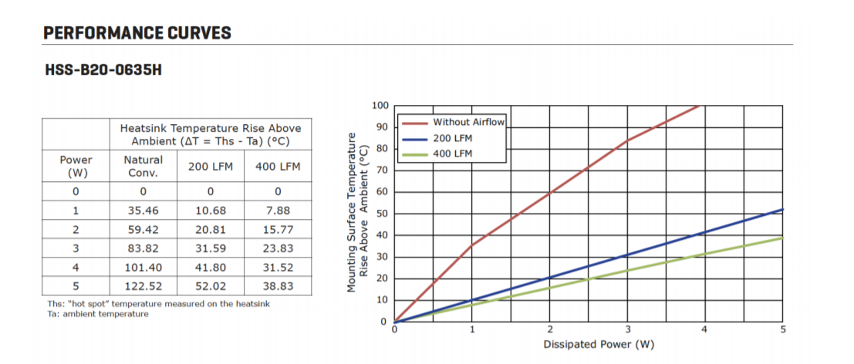
Diode Heatsink

Slide 32
Test Results

Slide 33
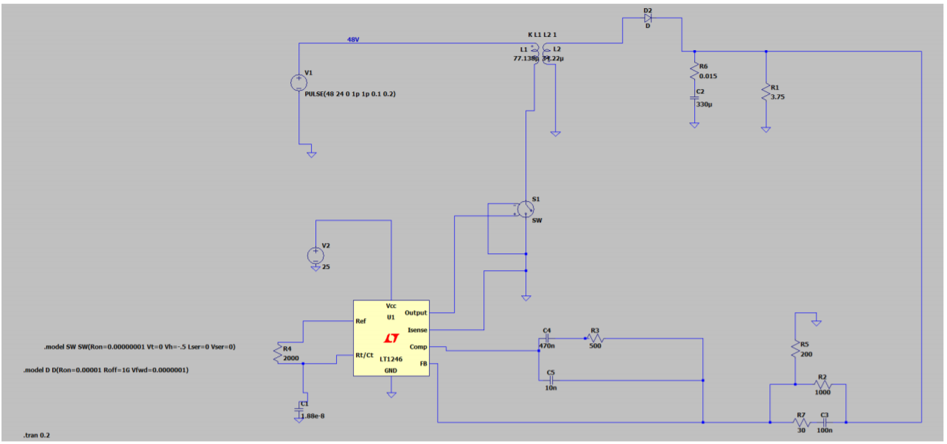
With Controller Spice Model

Slide 34
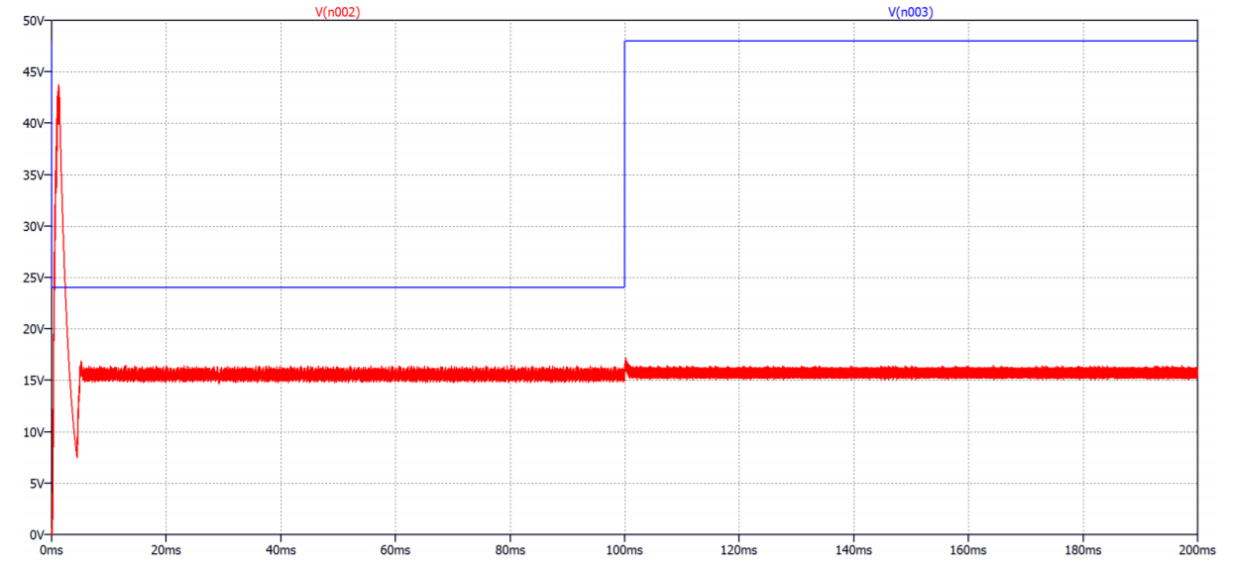

Slide 35
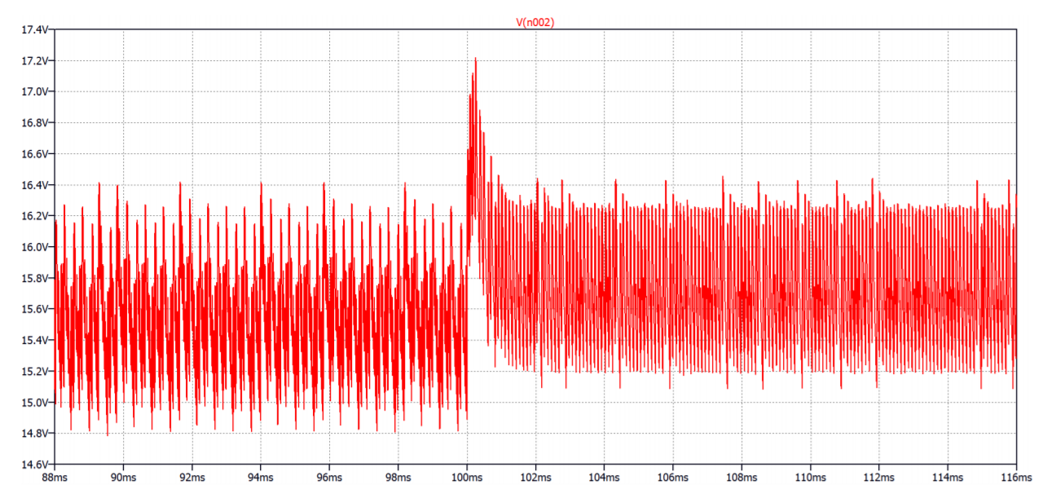

Slide 36
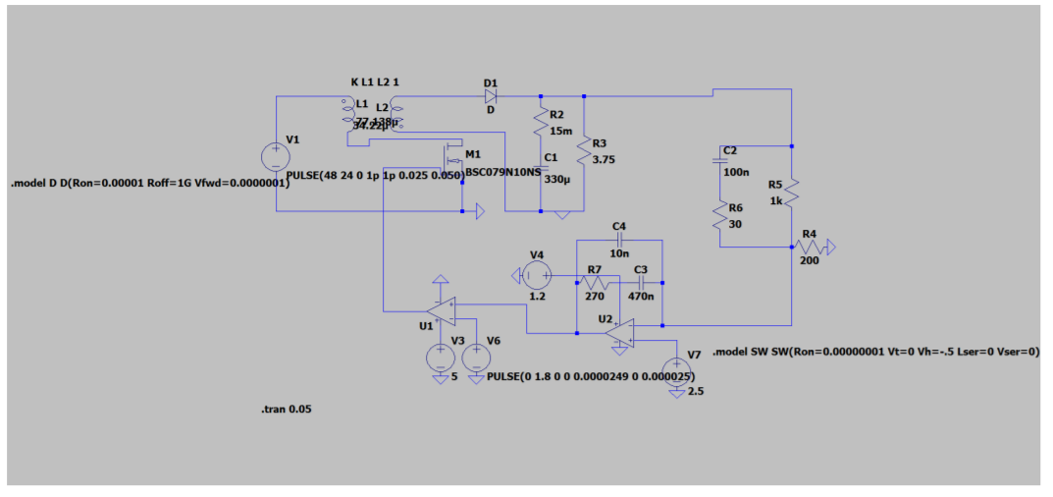
Without Controller

Slide 37
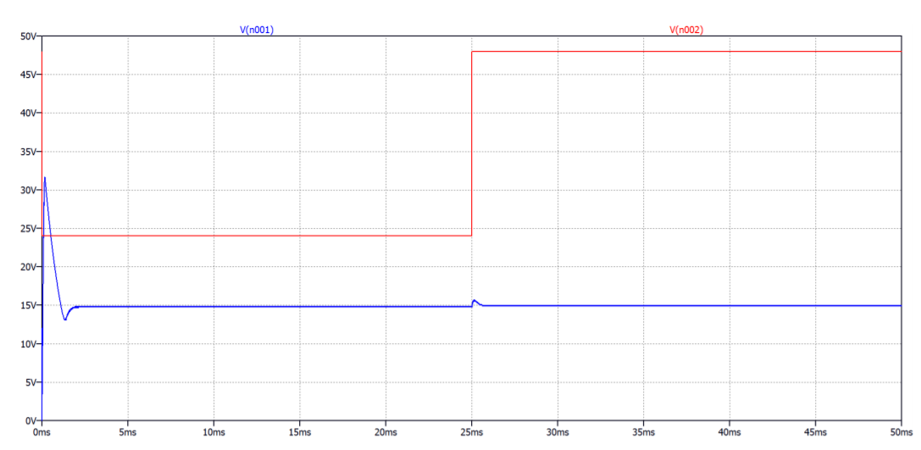

Slide 38
